Slide 1
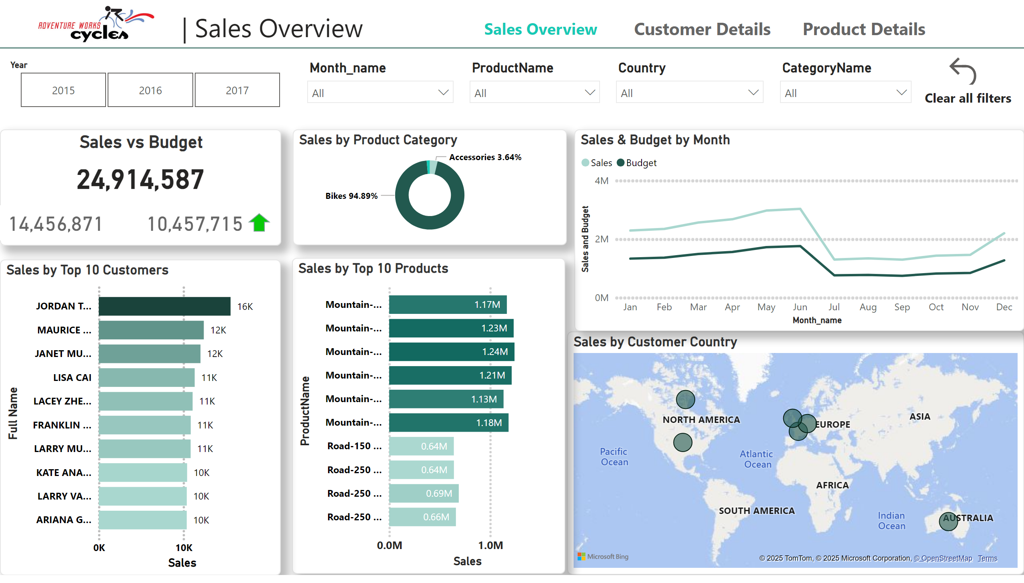
Sales Overview
Notes:
Sales by Product Category
No alt text provided
Sales by Customer Country
No alt text provided
Sales & Budget by Month
No alt text provided
Sales by Top 10 Products
No alt text provided
Sales by Top 10 Customers
No alt text provided
Sales Vs Budget
No alt text provided
textbox
No alt text provided
slicer
No alt text provided
Product Name
No alt text provided
Product Name
No alt text provided
Product Name
No alt text provided
Product Name
No alt text provided
textbox
No alt text provided
Clear all filters
No alt text provided
pageNavigator
No alt text provided
image
No alt text provided
Sales vs Budget
No alt text provided
Sales Vs Budget
No alt text provided
Sales Vs Budget
No alt text provided
shape
No alt text provided
shape
No alt text provided

Slide 2
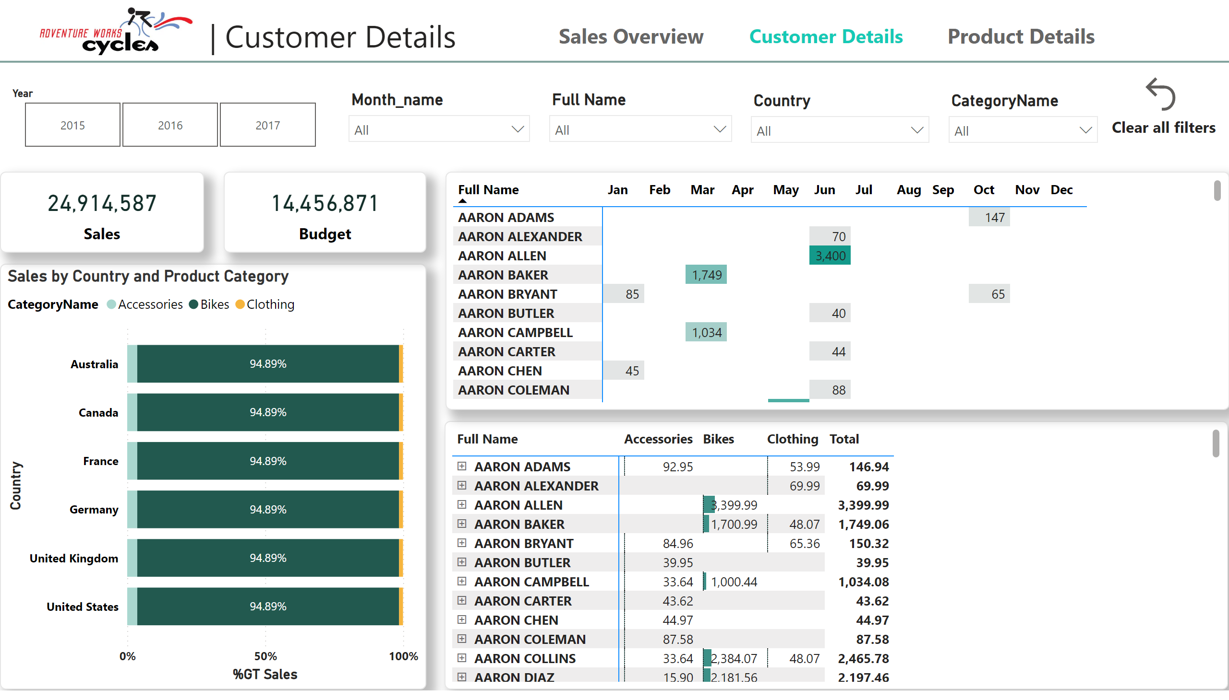
Customer Details
Notes:
Sales by Country and Product Category
No alt text provided
textbox
No alt text provided
pageNavigator
No alt text provided
Sales by Country and Product Category
No alt text provided
Sales by Country and Product Category
No alt text provided
slicer
No alt text provided
Product Name
No alt text provided
Product Name
No alt text provided
Product Name
No alt text provided
Product Name
No alt text provided
textbox
No alt text provided
Clear all filters
No alt text provided
pageNavigator
No alt text provided
image
No alt text provided
shape
No alt text provided
Sales
No alt text provided
Budget
No alt text provided

Slide 3
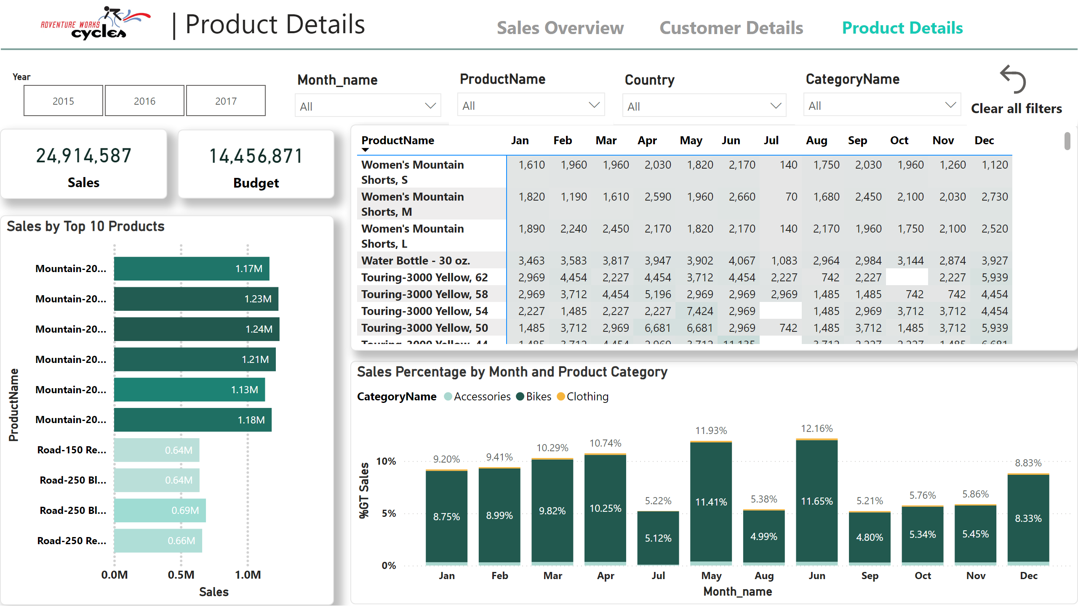
Product Details
Notes:
textbox
No alt text provided
Sales Percentage by Month and Product Category
No alt text provided
Sales by Country and Product Category
No alt text provided
slicer
No alt text provided
Product Name
No alt text provided
Product Name
No alt text provided
Product Name
No alt text provided
Product Name
No alt text provided
shape
No alt text provided
textbox
No alt text provided
Clear all filters
No alt text provided
pageNavigator
No alt text provided
Sales
No alt text provided
Budget
No alt text provided
Sales by Top 10 Products
No alt text provided
image
No alt text provided

